Slide 1
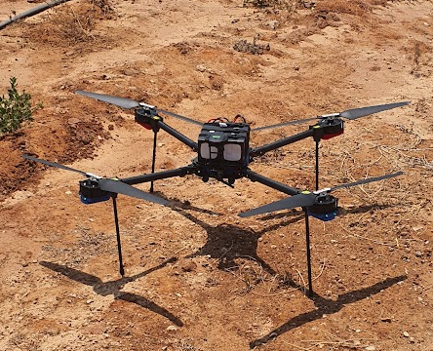
Flight Control Team
Here is where everything begins

Slide 2

9 Months Flies By
November – January | Learning about Linux, PID, and Nvidia Jetson.
January - March | Running a simulartor and cheacking the software.
March - May | Getting the Drone and the additional Parts like cameras
May - July | Installing the software on the real drone and making test flights.
July - August | Making the necessary files and presentation.
For more info: https://github.com/PX4/PX4-Avoidance#obstacle-detection-and-avoidance

Slide 3
TABLE OF CONTENTS
01
04
02
05
03
06
About the team
Sneak peek
Our team was making sure that the drone can fly safely
In the GitHub
Major requirements
Project stages
Safe Flight
Easy control
Excellent auto pilot
Learning
Planning
Execution
Project goals
Our team
Fly above the college Safely.
Head – Ofer Shahaf Maxim Melichov, Tom Vivdenko

Slide 4

OUR PROJECT
Customer (college) requirements from the drone to fly only within the college, Scan with a camera the area during the day, The Drone should encounter objects (obstacle avoidance), and identify humans.

Slide 5

01
About the project
Making sure we can walk before we can run

Slide 6
WHAT WE WERE WORKING ON
Simulator
We used the Rviz simulator to see if the software for the object avoidance works.
Influence
We checked that everything is working and will go flawless once installed on the drone.
The end result
The drone worked perfectly, we need more testing for object avoidance.

Slide 7
—Leonardo Da Vinci
“Once you have tasted flight, you will forever walk the earth with your eyes turned skyward, for there you have been, and there you will always long to return.”

Slide 8

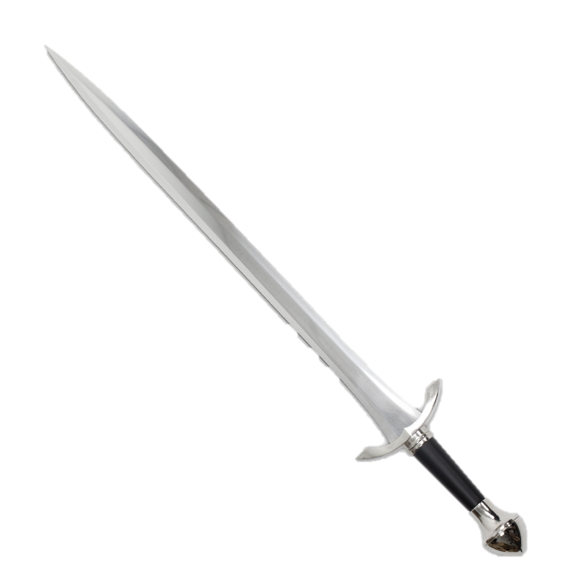
02
01
The components
sword is the extension of the arm

Slide 9
Drone
Price
Big features
The estimated price is $ 40,000
Name
Can carry a weight of 5 kg
Drone DR900 by Dronix.

Slide 10
Flight controller
Price
Big features
The estimated price is $ 300
• Backup system incorporates mixing, provides consistency Autopilot mixing modes and manual override
• Multi-colored LED main visual indicator
• External safety switch
• High volume, multi-tone audio slider
• High-speed microSD card for extended periods of time
Name
Pixhawk Model Cube Orange

Slide 11
Single board computer
Price
Big features
The estimated price is $ 180
Good over all performance
Name
Nvidia model jetson nano

Slide 12
Depth camera:
Price
Big features
The estimated price is $ 300
camera that detects distances between objects
Name
Intel® RealSense™ Depth Camera D435

Slide 13
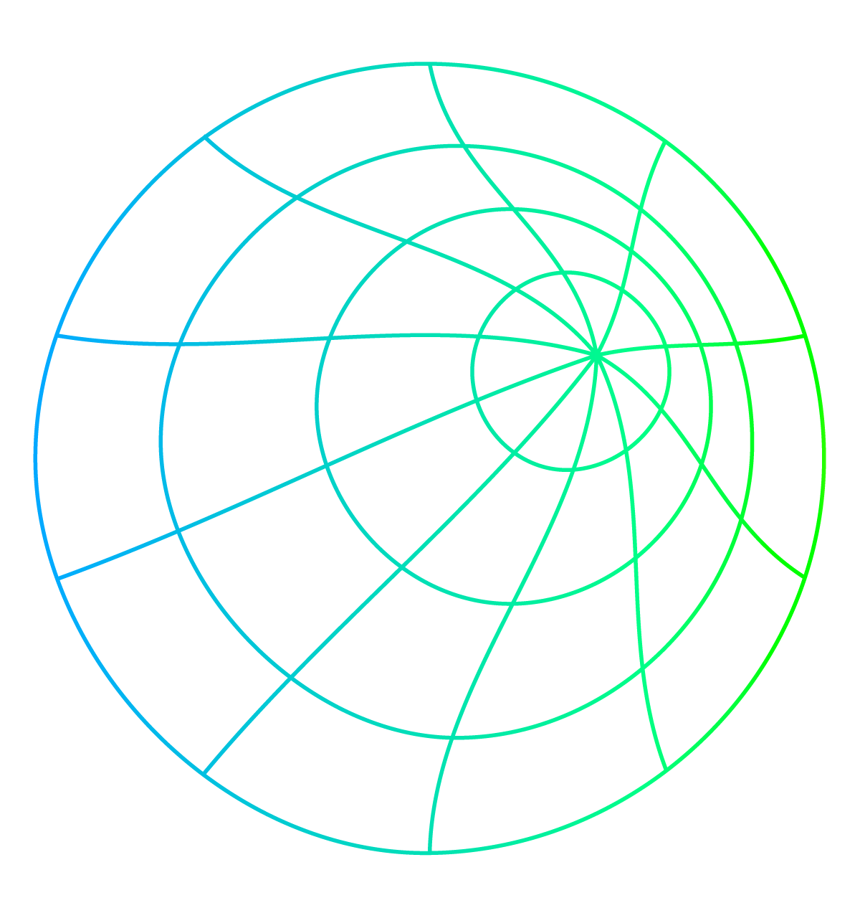
03
01
QGroundControl
Plan controller

Slide 14
OUR PARTNERS
Feature 1
Feature 2
Full definition / configuration
Mission planning for an autonomous flight
Feature 3
Feature 4
Flight map view showing the vehicle's location, flight route, waypoints, and vehicle instruments.
Streaming video with layers on the device display.

Slide 15
QGroundControl
Feature 1
Feature 2
Mission planning for an autonomous flight.
Flight map view showing the vehicle's location, flight route, waypoints, and vehicle instruments.

Slide 16
04
01
PX4
Automated machine

Slide 17
PX4
Feature 1
Feature 2
Feature 3
Knows how to work with the extra parts we work with whether it is
Jetson, Orange Cube, Lidar else
Venus has a beautiful name and is the second planet from the Sun
Task planning

Slide 18
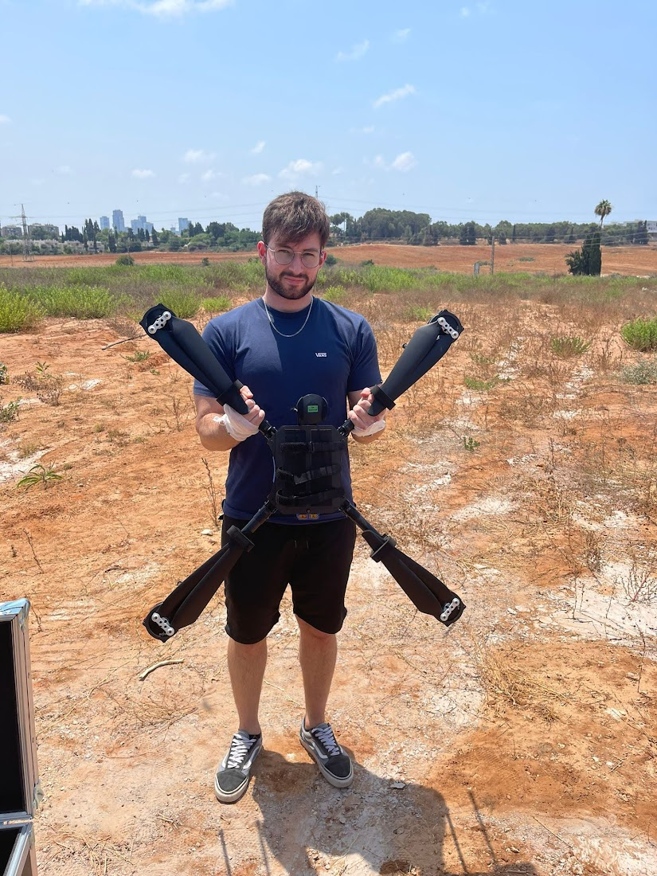
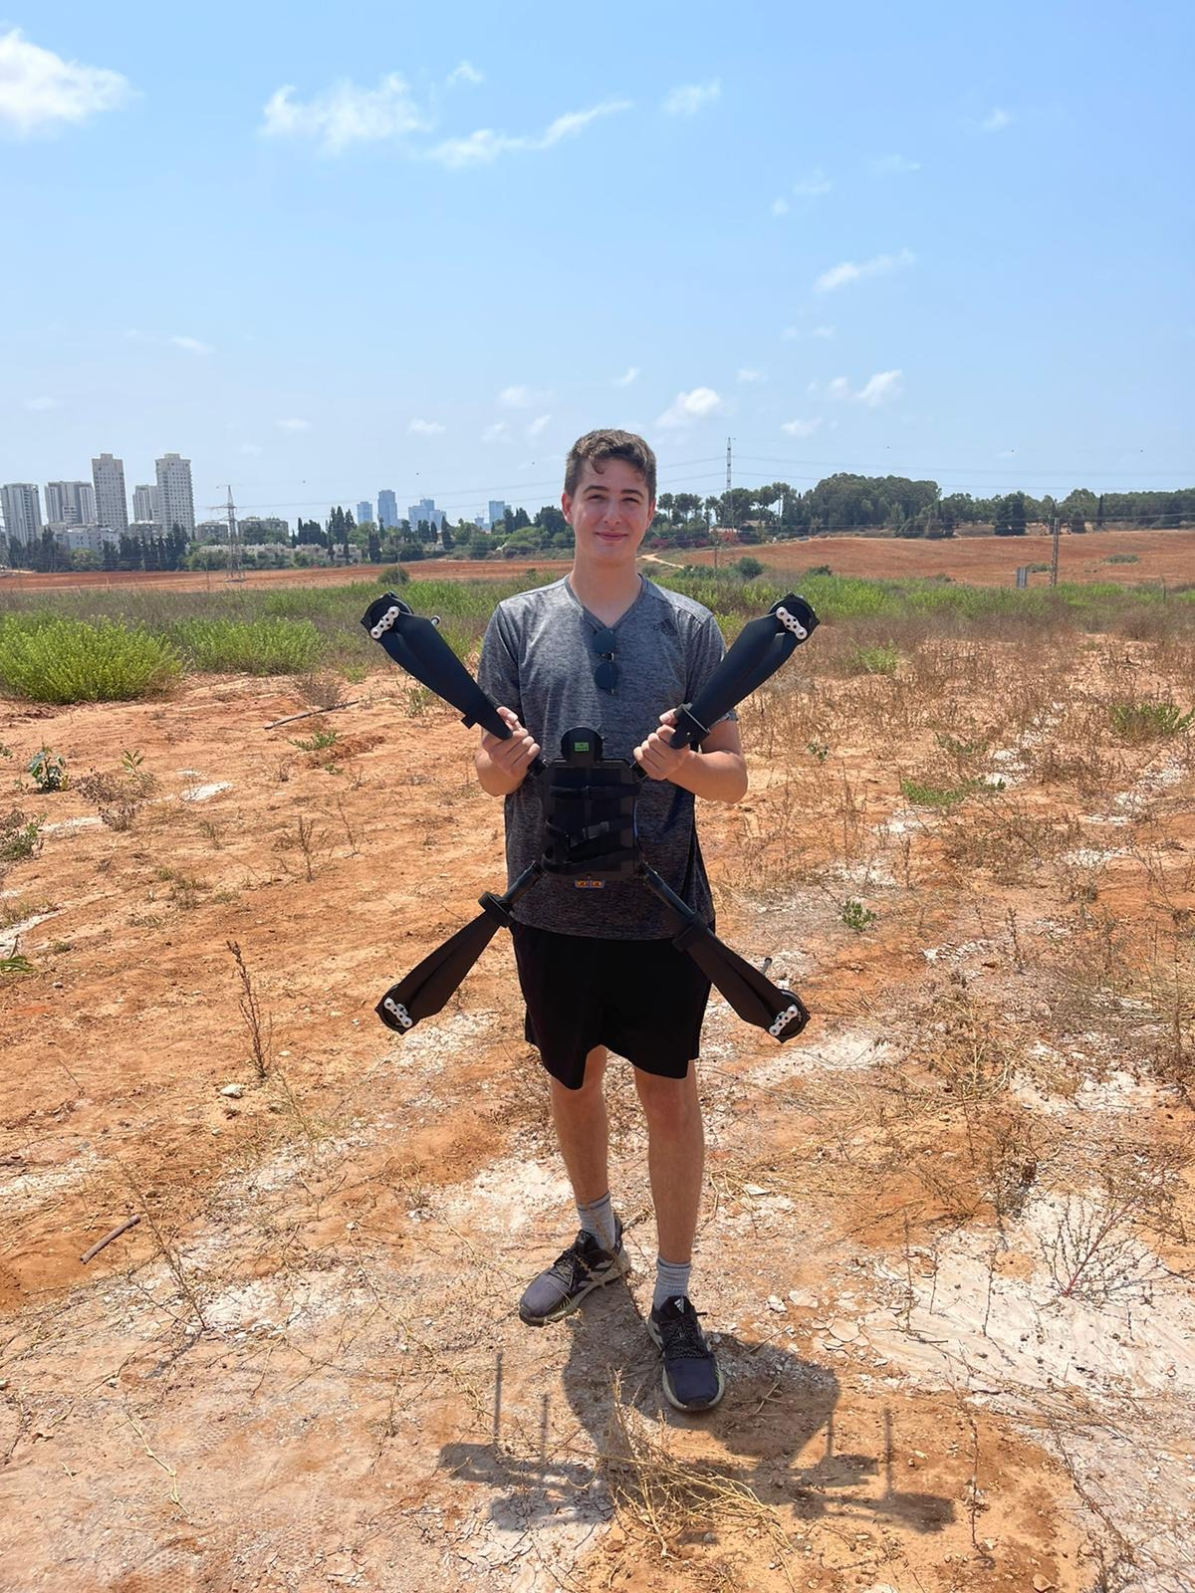
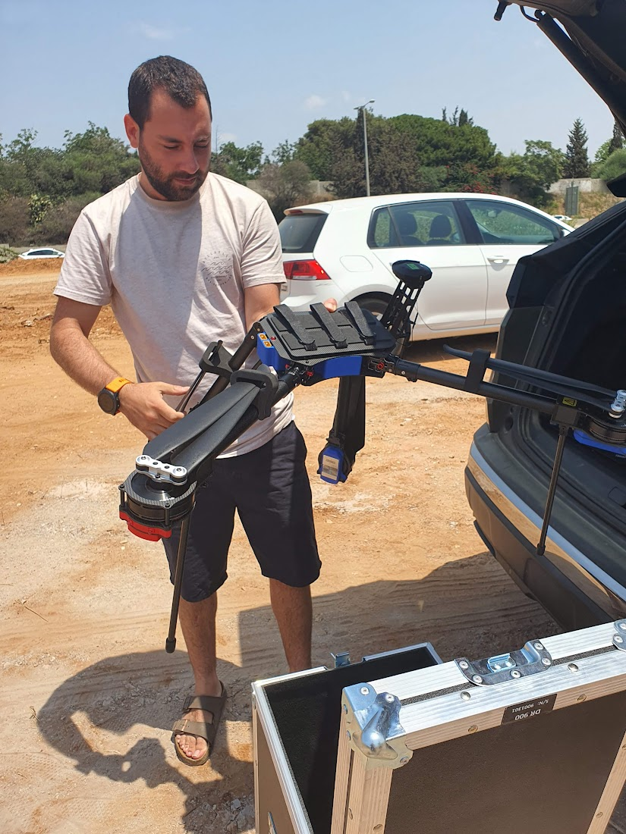
OUR TEAM
Maxim Melichov
Tom Vivdenko
Ofer Shahaf

